Slide 1
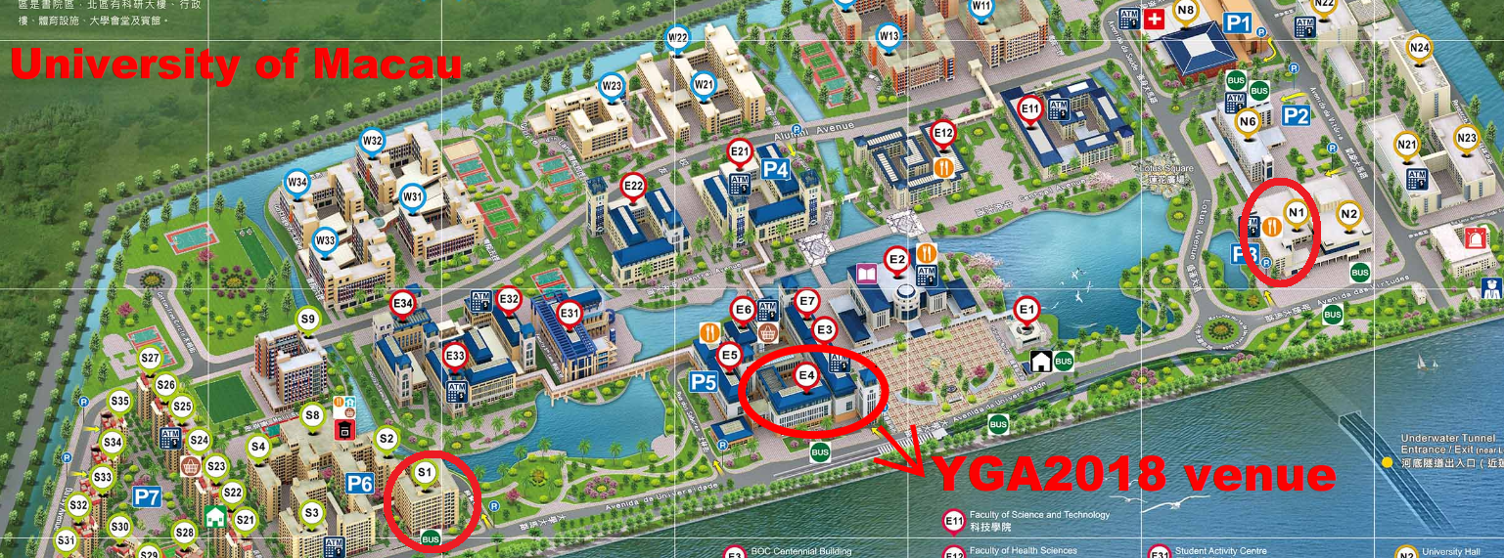
Lunch, dinner
S1 Hotel

